Slide 1
AREC 570 Slides

Slide 2
Unit 1
Foundations of Economic Research

Slide 3
Introduction
Greenlaw Ch 1; Ethridge Ch 2; Popper

Slide 4
Introduction
What is economic research?
What is the goal of economic research?
How do we do economic research?
How do we evaluate economic research?
Why should we study economic research methodology?

Slide 5
What is economic research?
“research is the systematic approach to obtaining new and reliable knowledge… the process by which we discover, evaluate, and confirm the stock of economic knowledge.” - Ethridge Ch 2
Farmer vs detective metaphor - knowledge is created through argument
Journals are the forum for discussion. “Through this dialog, arguments are evaluated, the weaker ones are winnowed out, and the stronger ones are refined and improved” (we will return to this in McCloskey)

Slide 6
Minimum wage example
Those doing economic research observe and theorize about the laws governing employment in a market economy.
From that theory comes a prediction that, ceteris peribus, an increase in the minimum wage above the equilibrium will result in lower employment.
This theory can then be evaluated by empirical study.
We either confirm or reject the theory and possibly revise theory.

Slide 7
Ethridge: What research is and isn’t
Research is the systematic approach to obtaining and confirming new and reliable knowledge
Research is:
Searching for explanations
A process
Research is not:
Accidental discovery
Data collection (though it is a critical part of research)
Searching out published research (though literature review is important part of the research process)

Slide 8
Basic and applied research
Basic: proposing new theories or methods and investigating their properties. Ex: new functional forms, new estimators. Audience is other economists/researchers
Fundamental economic research is still about human behavior
Disciplinary research
Applied: applying theories or tools to study real world problems.
Subject-matter: climate change
Problem solving: cap and trade in CA policy analysis
Both and interdependent and influence each other. How?

Slide 9
What is the goal of economic research?
To learn or better understand economic processes, relationships between people/firms in society, relationships between people and natural resources
Doing the research frequently requires solving problems… solving a model or doing econometrics, but this is not the goal of the research
Throughout the research process ask yourself
“Is what I am doing helping me achieve the goal of research”

Slide 10
How do we do economic research?
Apply methods to solve identified economic research questions
Identify questions → develop hypothesis (based on theory) → collect and analyze data → revise theory → repeat
Research does not proceed linearly or as easily as it may sound when reading a journal article. Often fits and starts with many dead ends.
Any examples?
Collaboration: Economics is inherently multidisciplinary. Economics deals with human activities that are affected by social religious political governmental institutional physical by and biological factors.

Slide 11
Research Process
Identify problem and develop research question
Formulate objectives
Plan and design research methods
Do project and generate results
Interpret and draw conclusions
Communicate your research to audience
Sub-discipline, discipline, academic, practitioners, general audience

Slide 12
Creativity
Prescriptive: creativity in converting research into policy
Transferable quota in commercial fishing
Applied: creativity in finding appropriate solution concepts to problems
Nash equilibrium to the location choice
Theoretical: drawing connections between abstract concepts
Fire and moral hazard
How can you cultivate creativity?

Slide 13
How do we evaluate economic research?
Evaluate an argument by thinking critically about the component parts: assumptions, logic, evidence
Is the logic flawed? This is usually handled by the model and logic is imposed by mathematics. Move toward empirics is making this less clear in papers
Are the assumptions necessary to draw the conclusions? Would changing the assumptions lead to different conclusions. Recognize implicit assumptions and try to make them explicit
Does the evidence support the conclusion?
Is the argument persuasive?

Slide 14
Why should we study economic research methodology?
Understanding the process by which we conduct research is the most efficient way to produce new knowledge
Methods vs. methodology
Methods are the specific details about how a problem is solved
  The other courses you will take cover methods of economics
Methodology provides the principles for organizing, planning, designing, and conducting research.
  The science and art of research
  Goal is to expand and confirm body of knowledge. Research methodology is the study of how we accomplish that goal.

Slide 15
Poppers Philosophy of Science
Evaluating logic
Modes of argument
Validity
Soundness
Forms of reasoning
Scientific Theory

Slide 16
Two modes of argument from philosophy
Modus ponens (mode that affirms): the rule of logic stating that if a conditional statement (“if p then q ”) is accepted, and the antecedent ( p ) holds, then the consequent ( q ) may be inferred.
Ex: If Socrates is a man then Socrates is mortal. Socrates is a man. Therefore, Socrates is mortal.
At one point, most research progressed in this way… and most people think that it does today.
Modus tollens (mode that denies): if p then q. The consequent (q) does not hold, therefore the antecedent (p) must not be true.
If Socrates is a god, then Socrates is immortal. Socrates is not immortal. Therefore, Socrates is not a god.
Popper’s philosophy proposes that we use modus tollens to carve away at untruths to hopefully leave truth remaining.

Slide 17
Examples: valid or invalid logic?
If Jane has a cat, then Jane has a pet.
Jane has a cat.
Therefore, Jane has a pet.
If Jane has a cat, then Jane has a pet.
Jane does not have a cat.
Therefore, Jane does not have a pet.
If utility is maximized subject to a budget constraint, then an individual is as happy as possible.
An individual is as happy as possible.
Therefore, utility must be maximized subject to a budget constraint.
If price equates supply and demand, the market is efficient.
The market is not efficient.
Therefore, price does not equate supply and demand.
If a market exists for a private good with complete information, the equilibrium is efficient.
A market exists for a good with complete information.
Therefore, the equilibrium is efficient.

Slide 18
Examples
If Jane has a cat, then Jane has a pet. (MP: Modus Ponens. The condition happened, so the consequence must happen.)
Jane has a cat.
Therefore, Jane has a pet.
If Jane has a cat, then Jane has a pet. (X DA: Denying the Antecedent. No cat -> no pet doesn’t logically follow.)
Jane does not have a cat.
Therefore, Jane does not have a pet.
If utility is maximized subject to a budget constraint, then an individual is as happy as possible.
An individual is as happy as possible.
Therefore, utility must be maximized subject to a budget constraint. (X AC: Affirming the Consequent. Invalid reasoning)
If price equates supply and demand, the market is efficient. (MT: Modus Tollens)
The market is not efficient.
Therefore, price does not equate supply and demand.
If a market exists for a private good with complete information, the equilibrium is efficient. (X Invalid MP)
A market exists for a good with complete information.
Therefore, the equilibrium is efficient.

Slide 19
Validity
An argument is valid if it is impossible for premise to be true while conclusion is false (regardless of whether the premises are true)
The argument is internally consistent
An argument here is the set of statements
Valid
All men are mortal.
Socrates is a man.
Therefore, Socrates is mortal.
Invalid
All men are immortal.
Socrates is a man.
Therefore, Socrates is mortal.

Slide 20
Soundness
An argument is sound if it is valid and the premises are true
Sound
All men are mortal.
Socrates is a man.
Therefore, Socrates is mortal.
Unsound
All birds can fly.
Penguins are birds.
Therefore, penguins can fly.

Slide 21
Inductive and Deductive Reasoning
Deductive reasoning: a series of assumptions and relationships (a general or universal statement and a specific or singular statement) lead to certain expected outcomes.
  Deductive reasoning, or deduction, starts out with a general statement, or hypothesis, and examines the possibilities to reach a specific, logical conclusion.
  Example: Equilibrium price is a deduced outcome of assumptions about market structure and motivation of producers and consumers.
  Deductive reasoning relies on the validity of the argument.
  Conclusions can be proven but the premises themselves are taken as given and may not be provable.
Inductive reasoning: extending a specific circumstance or outcome to a general conclusion.
  E.g., Statistical inference: taking a result based on a sample and extending it to the population.
  "The coin I pulled from the bag is a penny. That coin is a penny. A third coin from the bag is a penny. Therefore, all the coins in the bag are pennies."

Slide 22
Popper continued
Ingredients of a theory
4 Criteria to judge scientific theories
Internally valid
Testable
Popper’s chopper (falsifiable)
Withstand repeated empirical testing

Slide 23
Employment falls because of an increase in the min wage
People are rational
People have complete information
People want to earn more money in order to satisfy other wants
Firms want to hire at lowest wage rate
A wage above the equilibrium creates a labor shortage
Min wage blocks the system from tending toward equilibrium

Slide 24
Internal Validity
Theory consists of a set of foundational axioms (independent, free of contradiction) from which statements or logical conclusions may be deduced (hypotheses and predictions).
Our theory of the consumer is axiomatic. The statements provide the foundation for theory of demand. They are logically consistent and other statements can be deduced i.e., demand is downward sloping.
Examples: completeness (able to compare all bundles), transitivity, complete information, utility and profit maximization

Slide 25
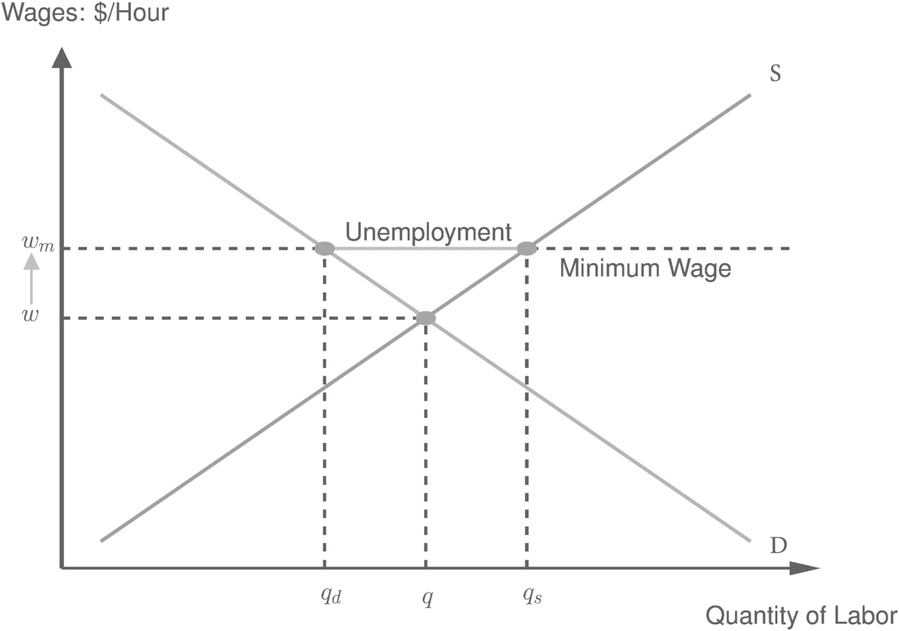
Min wage: Validity?
Consumer theory - labor supply
Production theory - labor demand

Slide 26
Testable
“Secondly, there is the investigation of the logical form of the theory, with the objective of determining whether it has the character of an empirical or scientific theory, or whether it is, for example, tautological”
3 requirements:
It must be a possible world
Demarcation, measurable, able to experience. Not metaphysical.
Must be distinguishable as our world that we live in.

Slide 27
Min wage: testable?
We can observe wages and employment as well as the implementation of policy

Slide 28
Popper’s chopper (Occam’s razor)
A theory that provides a more simple explanation (with fewer assumptions) is better
Why is popper so concerned with this?
Because the simple theory is easier to falsify.
The experiment necessary to falsify requires fewer assumptions to be met.

Slide 29
Min wage: simple?
Are there alternative explanations (theories) of how the min wage would impact employment?
If so, do they provide a simpler explanation of the effect?

Slide 30
Withstand repeated empirical test
The theory must survive repeated tests based on data collected from the world we experience.
We must subject the minimum wage hypothesis to repeated empirical scrutiny.
This can be particularly challenging in a discipline focused on human behavior where human behavior is often mediated through culture that may change over time. In other words, the world we experience may itself be changing requiring us to modify theory over time.

Slide 31
Min wage: withstand repeated testing?
Min wage has seen a renewed attention.
More empirical research finds little or no effect now.

Slide 32
Min wage example
Hypothesis: Assume simple (101) labor model, then minimum wage reduces employment relative to no policy case.
Prediction: If hypothesis is true, employment in Seattle should fall when minimum wage increased to $15/hr.
Test: We can empirically evaluate whether employment falls in response to minimum wage increase.
Use modus tollens: employment does not decline; therefore, hypothesis is not true. Hypothesis is not true; therefore, axioms are not true.
https://www.cato.org/policy-analysis/making-sense-minimum-wage-roadmap-navigating-recent-research#research-on-the-long-history-of-u-s-minimum-wage-changes

Slide 33
Concluding thoughts
Popper claims we must describe the rules of the method of science. What he means is a description of the context in which "science" occurs.
Science is without end
The stock of knowledge evolves over time
This systematic approach to science has two important implications:
No theory can be conclusively proven.
No theory can conclusively be disproven.
Modus ponens relies on the validity of the premise which cannot be proven or disproven.
Modus tollens does not test the theory directly – you cannot conclusively rule out other explanations.

Slide 34
Popper’s critics
Falsification criteria is too strict. Evolutionary bio cannot be falsified
Deduction and testing is too idealized. Science uses induction, abduction, analogy, intuition.
Popper’s view of science is too simplistic and does not account for historical, social, and cultural factors that influence science

